Slide 1
DDOS Detection
using Machine Learning

Slide 2
Introduction
What is Intrusion ? The act of someone that you don't know, who gains access to your computer without your permission.
Types of Intrusions:
DDOS
U2R
R2L
Probing Attack
What is intrusion detection system? Intrusion detection System(ID) can be
defined as a system for monitoring network security which prevents the occurrence of intrusions.

Slide 3
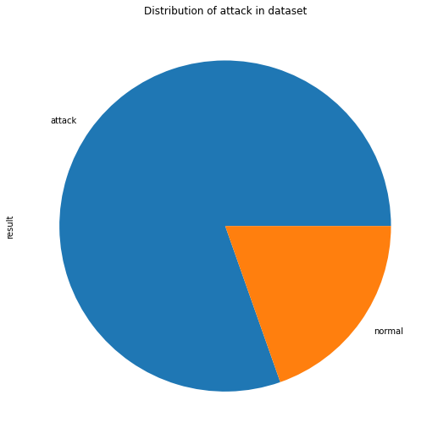
About the Dataset
KDD Cup 1999 Data
KDD has two week’s of attacks-free instances and five week’s of attack in- stances, making it suitable for anomaly detection.
Output classes are divided to 5 main categories: DOS (Denial of Service), Probe, R2L (Root 2 Local), U2R (User 2 Root) and Normal.
Dataset contains 39 attack types.Data here
is heavily imbalanced, approximately 80%
of it is attack traffic (3925650 attack instances out
of 4898430 instances in total).

Slide 4
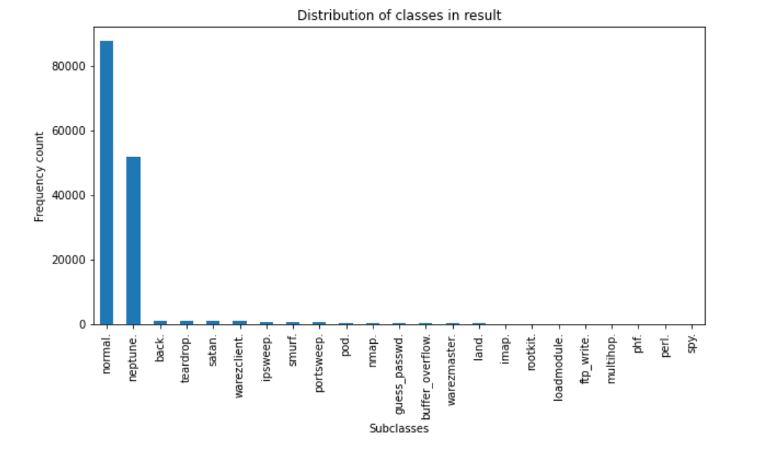
Data Exploratory analysis
Distribution
Normal-60%
Neptune-35%
Rest 38 classes 4%

Slide 5
Observations
Since this is a multi-class problem with 40 output classes
Classes are highly imbalanced.
Main objective is to predict the type of attack
Minimize the bad connection A bad connection can be any type of DDOS attack.
We focus on minimizing the false positive rate. (a bad connection classified as normal).

Slide 6
Features
Numerical
Total count - 38
21 numerical features have the range 1.( Min=0,Max=1)
17 features can be standardized
Categorical
Total count- 3
Protocol type Service flag

Slide 7
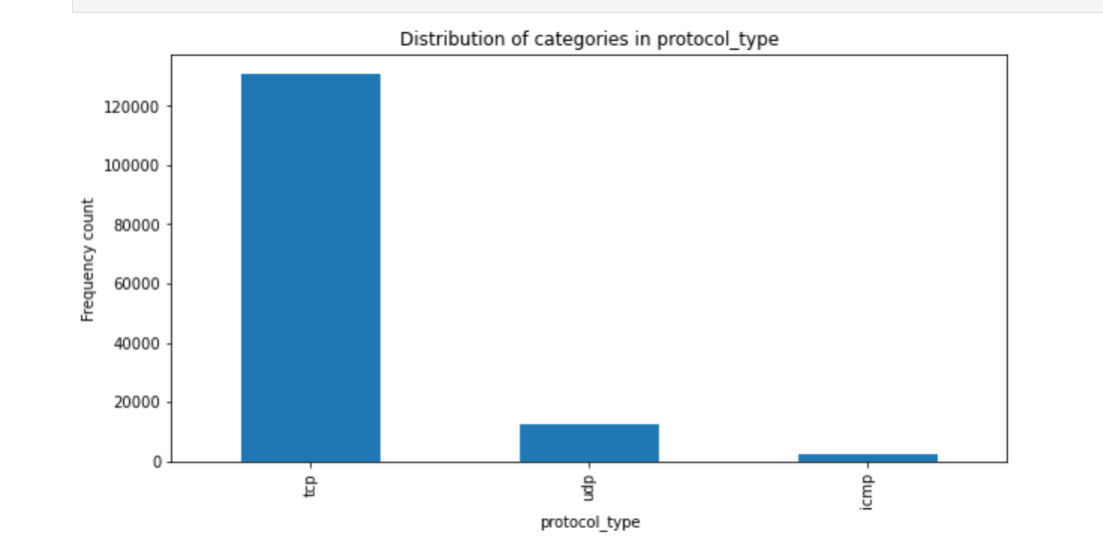
Distribution of Categorical Features- protocol_type
TCP- 90%
UDP-8.4%
ICMP-1.6%

Slide 8
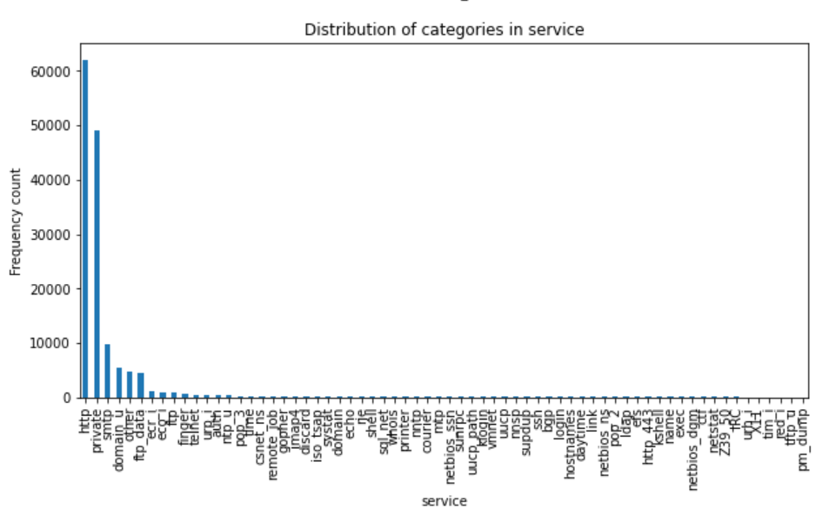
Distribution of Categorical Features- service
Http: 42.6%
Private: 33.7%
Rest 64 classes : 23.7%

Slide 9
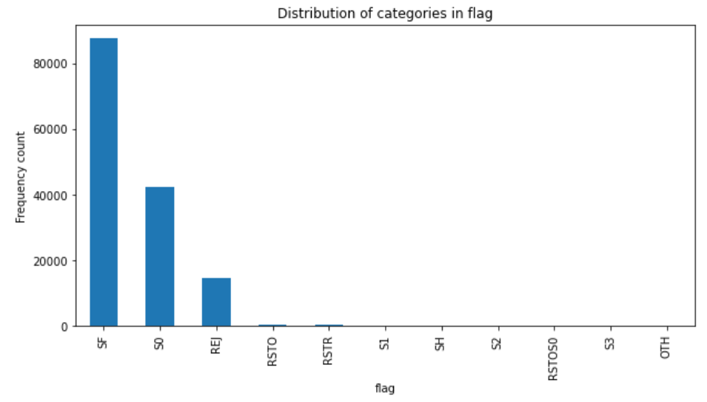
Distribution of Categorical Features - flag
SF: 60%
S0: 29%
REJ: 10%
Rest 8 class: 1%

Slide 10
Inference for categorical data
Categorical features are highly imbalanced.
Nominal
Hence, they need encoding
1st Approach : OneHot Encoder Sub-categories in protocol_type: 3 Sub-categories in service: 66 Sub-categories in flag: 11
Onehot Encoding would have result in (66+11+3-3) = 77 columns
This would increase the complexity of the model,due to increase in dimension.
Alternate approach: BaseN Encoding.
This would result in addition of (7+4+2)-3 = 10 columns

Slide 11
FEATURE SELECTION
As there are large number of features, the complexity increases with the number of samples
The probability of overfitting is very high
Hence by removing the irrelevant and redundant features, difference can be seen in the original dataset

Slide 12
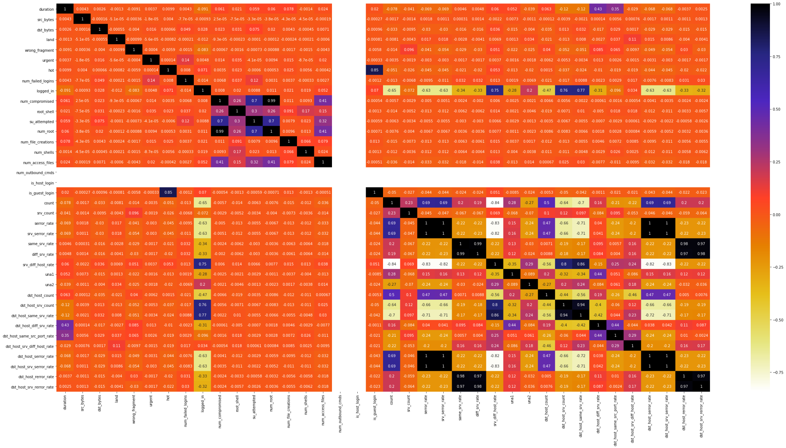

Slide 13
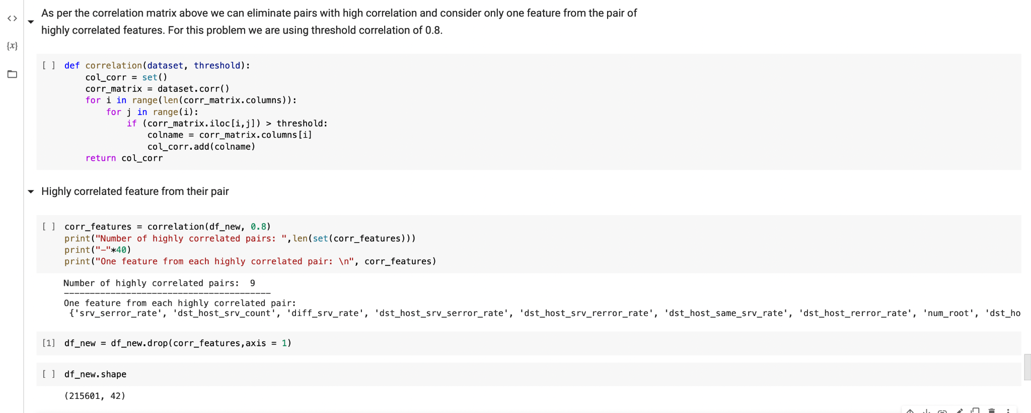

Slide 14
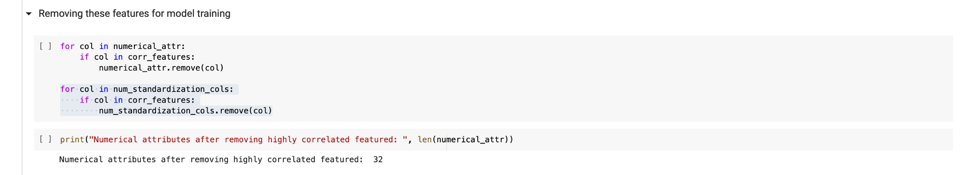

Slide 15
Pre-Processing of Data
After Dropping the features with high correlation, we will apply BaseN encoding.
Base = 2.
transforming categorical attributes
After transforming categorical attributes we got 45 columns.
Dividing dataset in train and test.

Slide 16
Train-Test-Split
We used StratifiedShuffleSplit
This helps us to ensure we preserve percentage of each class
Ratio -> 80:20
After splitting our train dataset is still unbalanced.
Reason to do after splitting dataset? Bias Data in test dataset
To solve this problem we applied different methods.

Slide 17
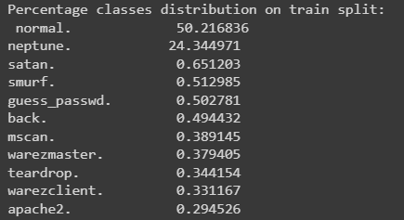
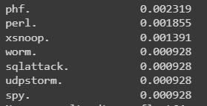
Data Imbalance after split
From the figures below we can see that there is still class imbalance problem to be resolved.
To resolve this problem we applied different techniques of oversampling and undersampling.

Slide 18
Oversampling and undersampling
After splitting few attack types had less than 10 data points in train dataset compared to 100000+ “normal” type.
Oversampling -> Randomly duplicates instances in the minority class.
Undersampling -> Randomly deletes instances in the majority class.
Problem with Undersampling -> some of the attacks consists only 1 data point leading to not enough data.
Problem with Random Oversampling -> by duplicating same value we increase biasing and hence risk of overfitting.

Slide 19
SMOTE(Synthetic Minority Oversampling Technique)
It is an type of oversampling technique.
Works by utilizing k-nearest neighbour algorithm.
Used to synthesize data where the features are continuous and classification
Problems? SMOTE may sometimes consider neighbours from other classes
For our dataset we used combination of random over sampler and SMOTE
Before we applied SMOTE -> Counter({'normal.': 108268, 'neptune.': 52488, 'satan.': 1404,....'spy.': 2, 'udpstorm.': 2, 'sqlattack.': 2, 'worm.': 2})
After we applied SMOTE -> Counter({'normal.': 108268, 'neptune.': 108268,'satan.': 108268,....'spy.': 108268, 'udpstorm.': 108268, 'sqlattack.': 108268, 'worm.': 108268})

Slide 20
Standardizing of Data
It is process of bringing data into a uniform format.
Mean = 0
Standard deviation = 1
Why after splitting?

Slide 21
Machine Learning Algorithms
Let’s see how we have trained the data using various ML models

Slide 22
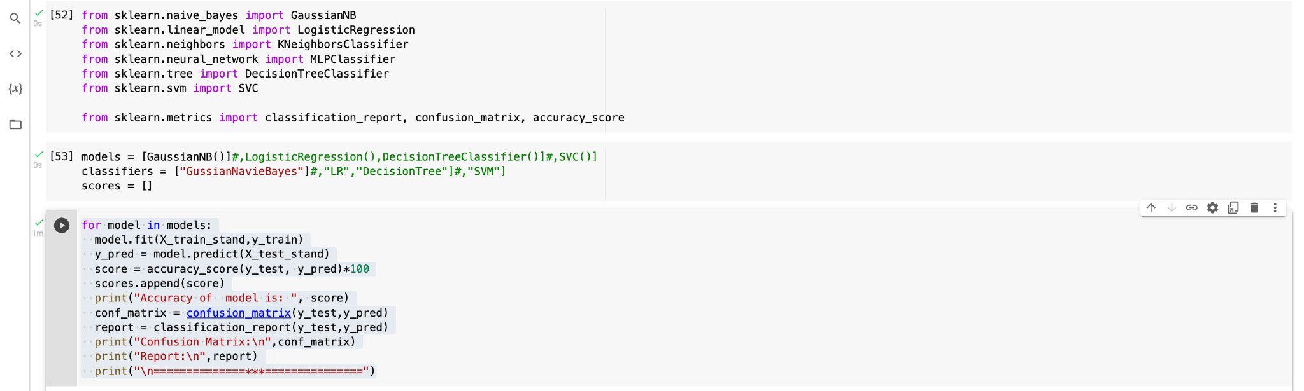
Naive Bayes

Slide 23
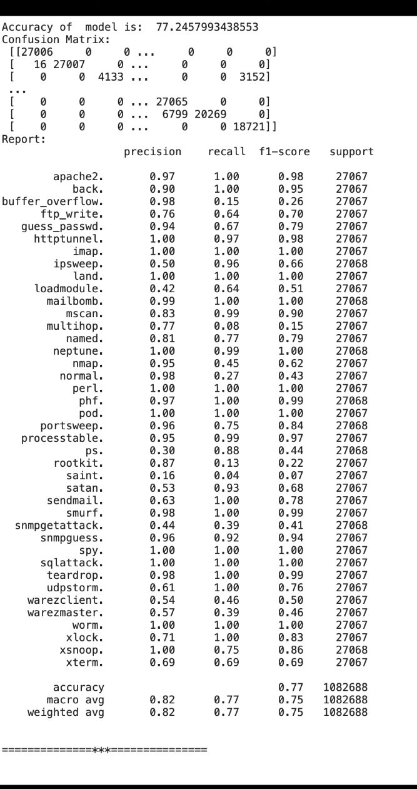
Accuracy = 77.24%
Precision = 0.82
Recall = 0.77
F1-score = 0.75
Precision for normal = 0.98
Recall for normal = 0.27
F1 score for normal = 0.43

Slide 24
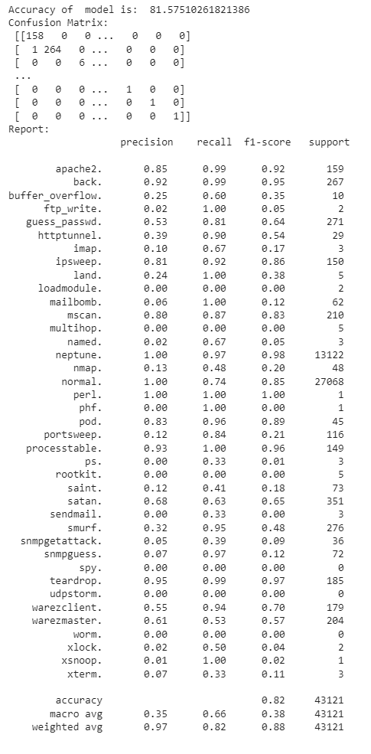
Logistic Regression
Accuracy = 81.58%
Precision = 0.35
Recall = 0.66
F1-score = 0.38
Precision for normal = 1.00
Recall for normal = 0.74
F1 score for normal = 0.85

Slide 25
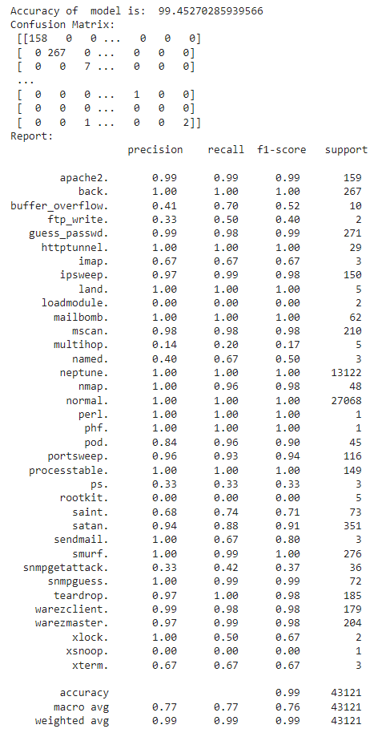
Decision Tree
Accuracy = 99.45%
Precision = 0.77
Recall = 0.77
F1-score = 0.76
Precision for normal = 1.00
Recall for normal = 1.00
F1 score for normal = 1.00

Slide 26
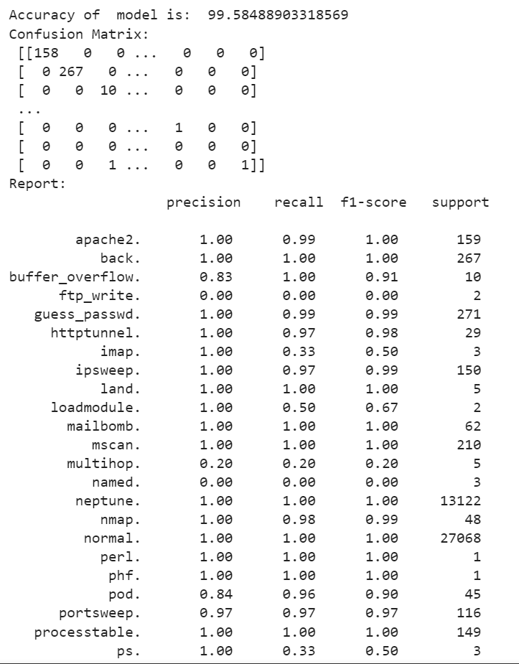
Random Forest
Accuracy = 99.58%
Precision = 0.83
Recall = 0.75
F1-score = 0.77
Precision for normal = 1.00
Recall for normal = 1.00
F1 score for normal = 1.00

Slide 27
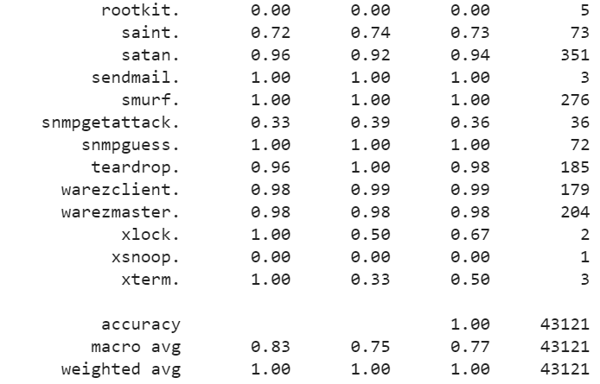

Slide 28
Conclusion
Random forest has highest accuracy of all 99.58%, with high precision, recall and f1 score.

Slide 29
THANK YOU

